Slide 1

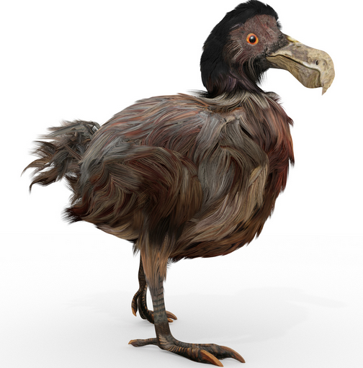

Законы эволюции
Игорь Рузин, в.н.с., группа Иммуногенетики ИЭФБ РАН
Notes:
Je vais vous raconter l'histoire de la sélection naturelle, qui est responsable de toute la diversité de la vie sur la planète.

Slide 2
Детерминистическая эволюция из первых принципов: 2 аллели
Количества геномов двух типов
Фитнесс меньше
Фитнесс больше
μ
κ (1−s)
κ
n₁ мутантов
n₂ дикий тип
ω
ω

Slide 3
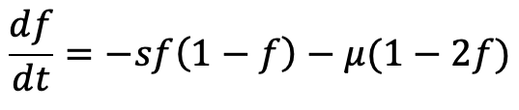
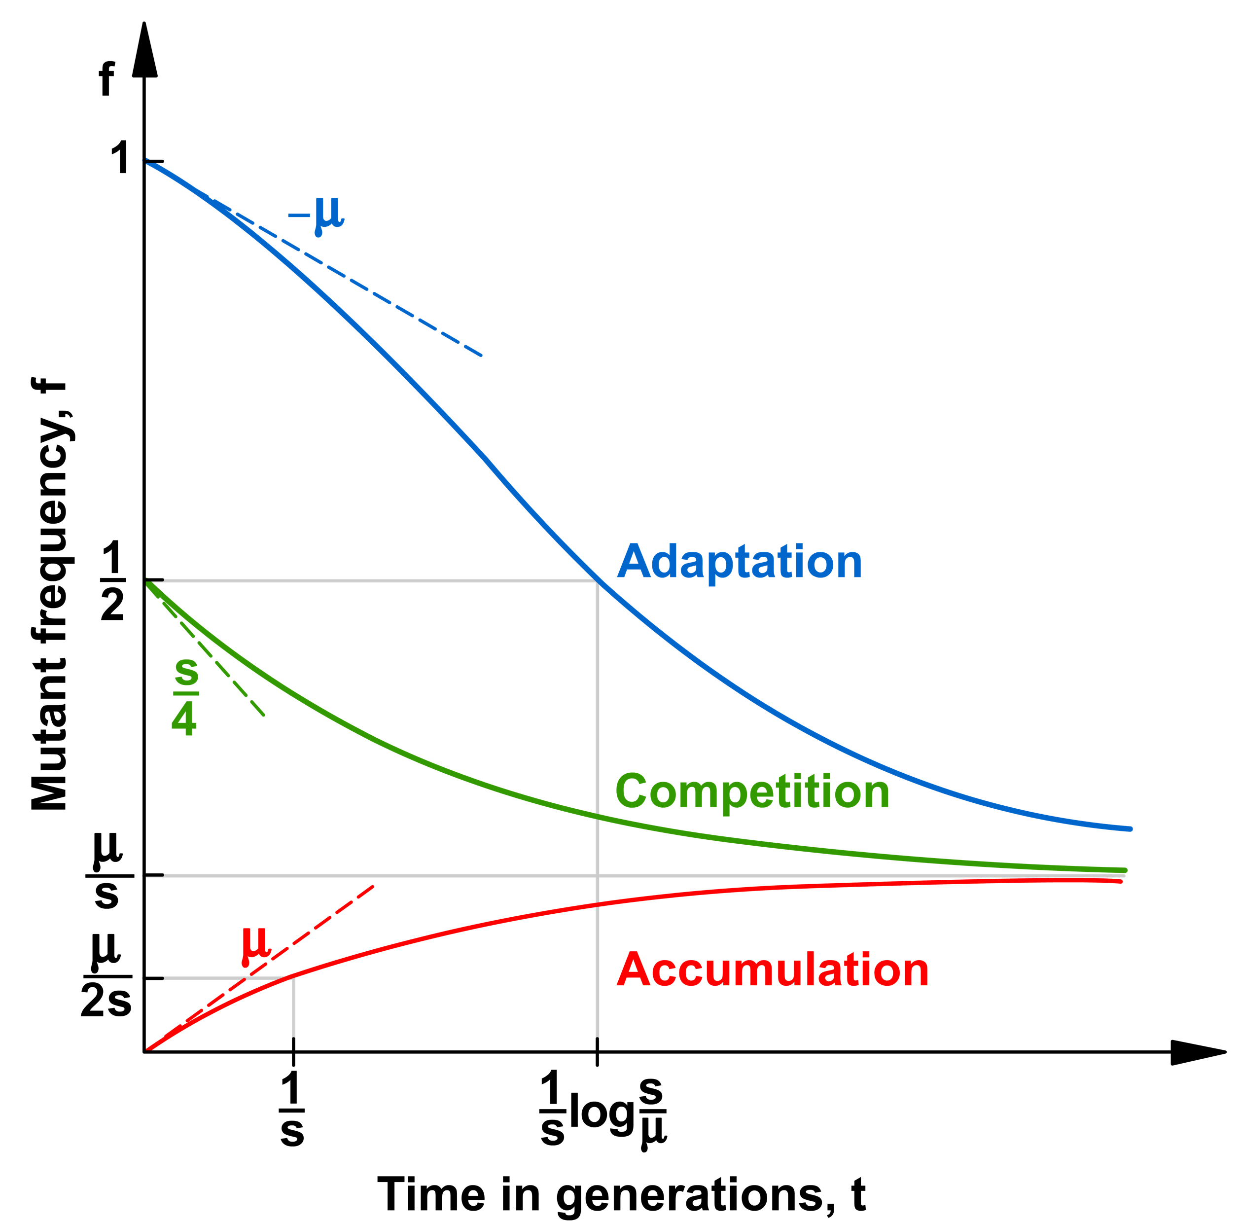
ВИЧ вырабатывает сопротивление анти-вирусной терапии

Slide 4
План лекции
Час 1: Почему ВИЧ столь полиморфен внутри пациентов? Данные секвенирования и 1 локусная модель. Стохастическая передача вируса,
Час 2: Ко-инфекция, иммунный отклик, и эпистаз.

Slide 5
Моделирование эволюции популяций
Предсказать динамику эволюции популяции геномов
Определить главные факторы
Сравнить с экспериментом (образцы ДНК)
Литература
Факторы
Приближения
Уравнения
Решение
Устойчивость
Вопросы
Данные
СТОП

Slide 6
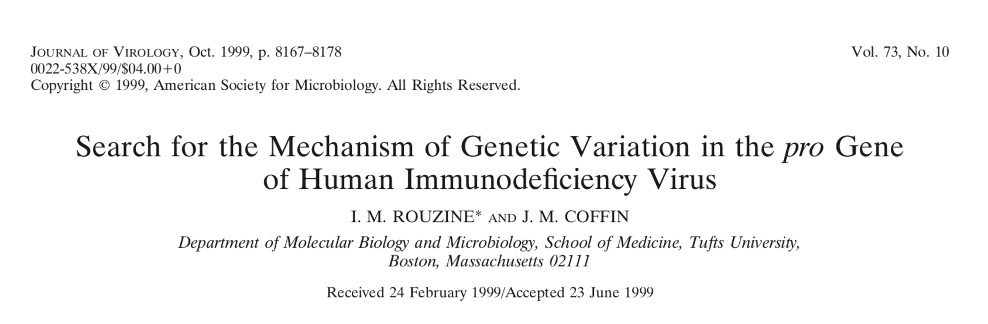
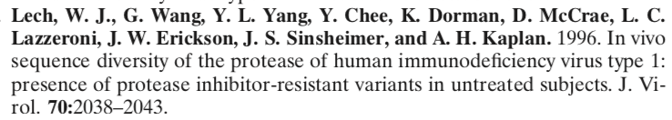
Откуда высокая гетерозиготность ВИЧ
Модель:
Данные:
Notes:
To obtain a more detailed picture of genetic variation in pro, we analyzed the database of se- quences described by Lech et al. (22). Sequences were ob- tained at a single time point from protease-inhibitor-naive patients. The 265 clones of proviral DNA were derived from peripheral blood mononuclear cells of 13 individuals by 70 cycles of nested PCR amplification, and the consensus se- quence for each patient’s virus was obtained. Of the 13 pa- tients, two (06 and 12) had stop codons in their consensus sequences and were excluded from further analysis. For the remaining 11 patients, 6% of the sequences contained dele- tions, insertions, or stop codons; these sequences were also filtered out, since the present work addresses point mutations, which do not render the virus nonviable. The remaining data- base comprised 213 clones of proviral DNA. We determined the common consensus sequence by noting the most frequent variant for each base. The consensus sequence starts from the conserved sequence CCTCAgATCACTCTT (PQITL), where g shows a variable base, and is 297 bases long. It is identical to the subtype B consensus in the LANL database (19a). Of the total number of substitutions, 25% were transversions with respect to the consensus sequence. To simplify further analysis, we ignored transversions, replacing them by the consensus sequence. As a result, each base was represented by two ge- netic variants: either A/G or C/T. (A theory taking into con- sideration both types of mutation would have to contain more parameters, namely, the forward and reverse mutation rates for transversions, which are very low and known with poor accuracy. This would complicate the theory without much gain in information.) Finally, to partially correct for errors accumlated during PCR, we ignored mutations present in a single copy in the entire database.

Slide 7
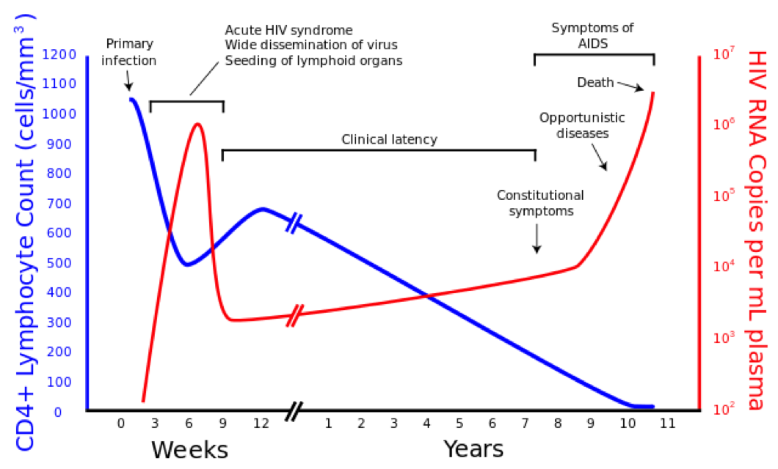
HIV dynamics
Квази стационарное состояние

Slide 8
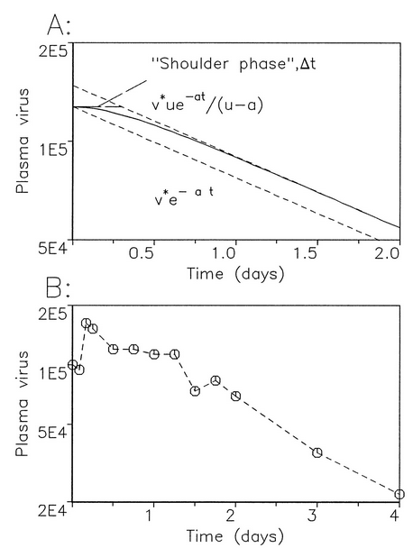
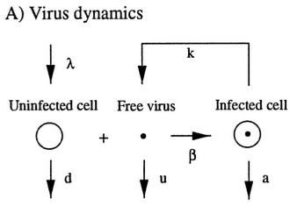
Быстрая ротация вируса
зараженная клетка живет 1 день (Ho et all 1995)
Bonhoeffer, May, Shaw, and Nowak, 1997

Slide 9
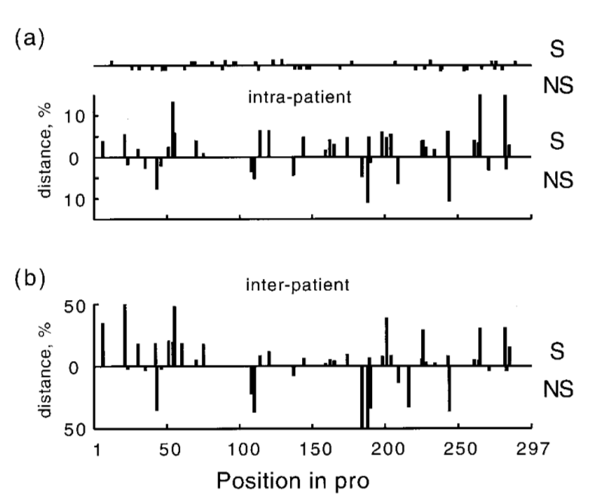
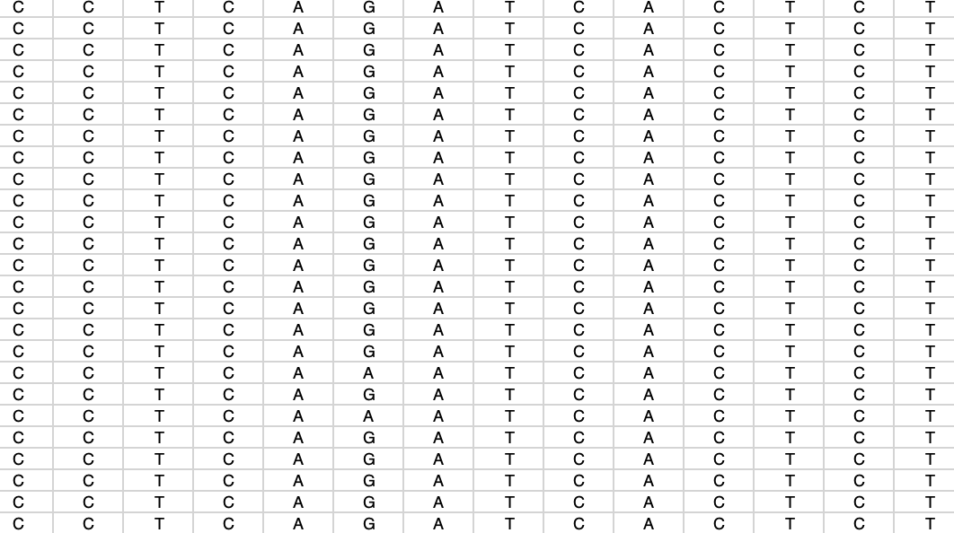
Гетерозиготность ВИЧ внутри и между пациентами
Т = 2 f(1-f)
Позиция в протеазе
Разные изоляты
Т₁₂ = 2 f₁(1-f₂)
Notes:
Intrapatient (a) and interpatient (b) genetic distances, averaged over patients, at different positions in pro. The upper and lower histograms in each figure correspond to synonymous and nonsynonymous sites, respectively. Dots on the upper horizontal line in panel a show the positions of sporadic mutations (seen only once in the data set).

Slide 10
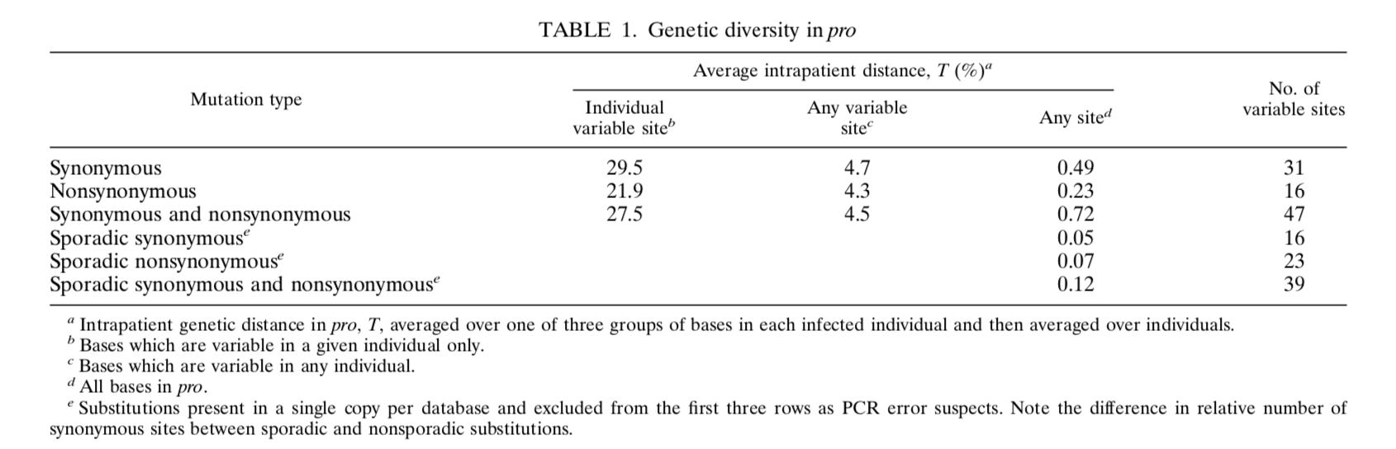
Ген. расстояния ВИЧ между пациентами в протеазе (297 nt)
47 гетеролокусов на 297нт
На весь вирус, 10,000нт, их > 1500

Slide 11
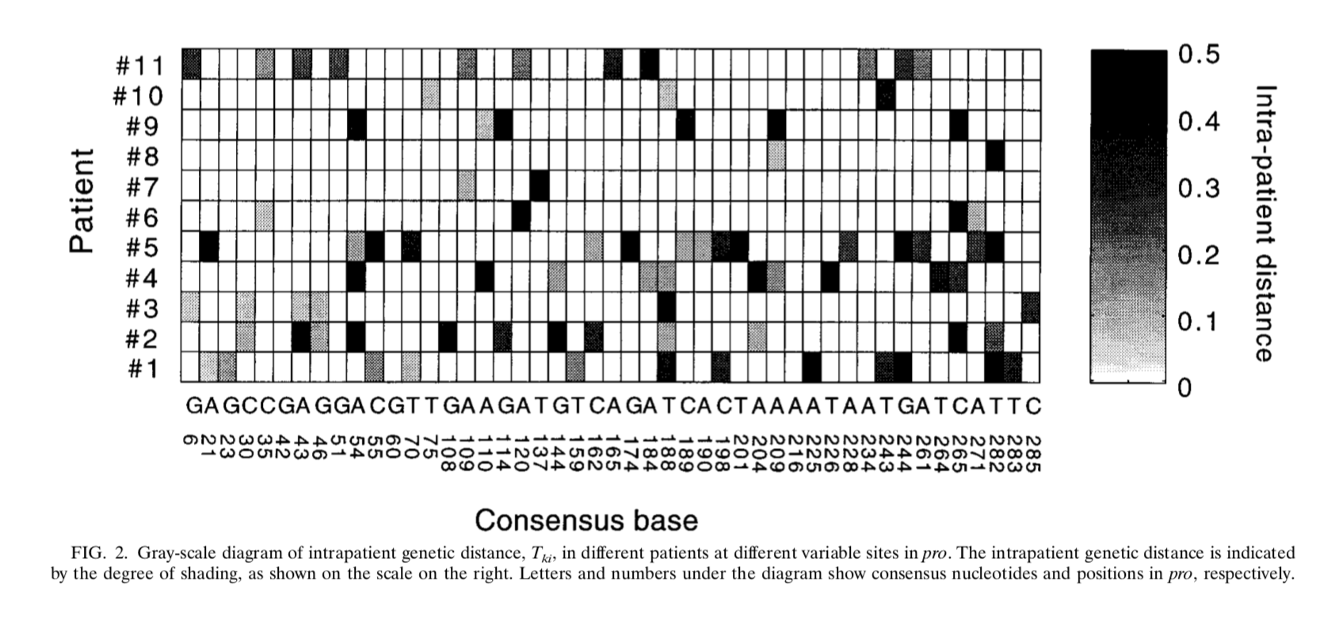
Ген. расстояния ВИЧ внутри пациентов
Т = 2 f(1-f)
Notes:
Gray-scale diagram of intrapatient genetic distance, Tki, in different patients at different variable sites in pro. The intrapatient genetic distance is indicated by the degree of shading, as shown on the scale on the right. Letters and numbers under the diagram show consensus nucleotides and positions in pro, respectively.

Slide 12
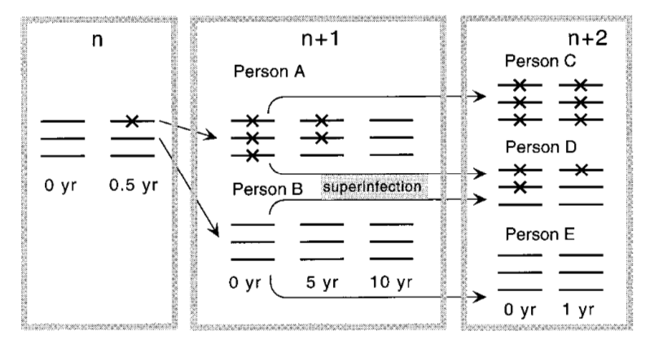
Передача от пациента к пациенту
Notes:
Model of evolution of a nucleotide along the chain of infected individuals under purifying selection. The numbers at the top denote cycles of transmission. X signs denote mutants. A mutant base appears spontaneously in person n, who infects person A with the mutant and person B with the wild-type variant. Person A passes the mutant down the chain to person C, after which his/her own virus population slowly reverts to the wild type. In person D, who is stably coinfected with a pair of sequences polymorphous at that base, selection clears the mutant virus rapidly.

Slide 13
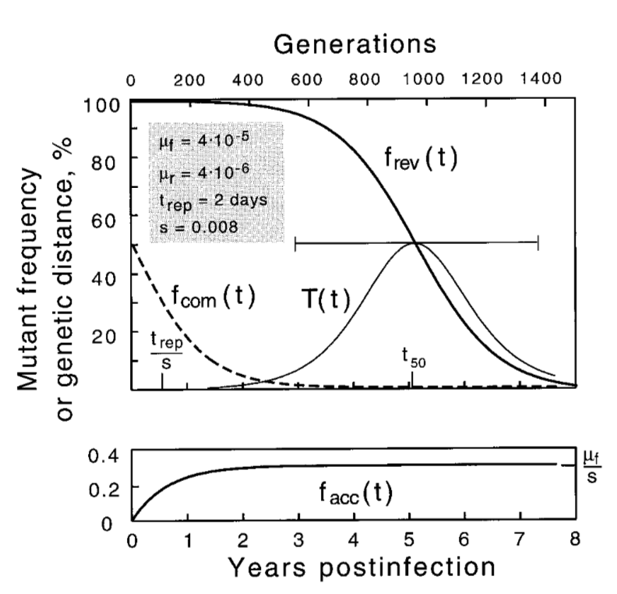
Реверсия мутантов внутри пациента обьясняет высокую гетерозиготность
Т = 2 f(1-f)
Дано:
скорость мутации 10⁻⁵
скорость ротации ½ день,
среднее время 5 лет
Подгонка: s=0.008
Notes:
Time dependence of the mutant frequency at different initial popu- lations: purely mutant (reversion) (thicker line in upper panel), purely wild type (accumulation) (lower panel), or 50% mutant (growth competition) (dashed line). The thinner curve shows the intrapatient genetic distance T(t) during reversion. The horizontal bar is the time interval during which the base would be classified as variable (5 to 95%). Values shown in the upper left corner corre- spond to parameters as follows: the forward (wild type 3 mutant) and reverse mutation rates, 􏰐f and 􏰐r, corresponding to either A or C wild type; the repli- cation cycle time, trep; and selection coefficient, s. The reversion half-time, t50, is given by the equation t50 􏰇 (trep/s)ln(s/􏰐r).

Slide 14
Почему так много полиморфных локусов?!
Стохастическая передача одного вируса
Notes:
Time dependence of the mutant frequency at different initial popu- lations: purely mutant (reversion) (thicker line in upper panel), purely wild type (accumulation) (lower panel), or 50% mutant (growth competition) (dashed line). The thinner curve shows the intrapatient genetic distance T(t) during reversion. The horizontal bar is the time interval during which the base would be classified as variable (5 to 95%). Values shown in the upper left corner corre- spond to parameters as follows: the forward (wild type 3 mutant) and reverse mutation rates, 􏰐f and 􏰐r, corresponding to either A or C wild type; the repli- cation cycle time, trep; and selection coefficient, s. The reversion half-time, t50, is given by the equation t50 􏰇 (trep/s)ln(s/􏰐r).

Slide 15
Почему так много полиморфных локусов?!
Стохастическая передача одного вируса
Notes:
Time dependence of the mutant frequency at different initial popu- lations: purely mutant (reversion) (thicker line in upper panel), purely wild type (accumulation) (lower panel), or 50% mutant (growth competition) (dashed line). The thinner curve shows the intrapatient genetic distance T(t) during reversion. The horizontal bar is the time interval during which the base would be classified as variable (5 to 95%). Values shown in the upper left corner corre- spond to parameters as follows: the forward (wild type 3 mutant) and reverse mutation rates, 􏰐f and 􏰐r, corresponding to either A or C wild type; the repli- cation cycle time, trep; and selection coefficient, s. The reversion half-time, t50, is given by the equation t50 􏰇 (trep/s)ln(s/􏰐r).

Slide 16
Почему так много полиморфных локусов?!
Стохастическая передача одного вируса
Notes:
Time dependence of the mutant frequency at different initial popu- lations: purely mutant (reversion) (thicker line in upper panel), purely wild type (accumulation) (lower panel), or 50% mutant (growth competition) (dashed line). The thinner curve shows the intrapatient genetic distance T(t) during reversion. The horizontal bar is the time interval during which the base would be classified as variable (5 to 95%). Values shown in the upper left corner corre- spond to parameters as follows: the forward (wild type 3 mutant) and reverse mutation rates, 􏰐f and 􏰐r, corresponding to either A or C wild type; the repli- cation cycle time, trep; and selection coefficient, s. The reversion half-time, t50, is given by the equation t50 􏰇 (trep/s)ln(s/􏰐r).

Slide 17
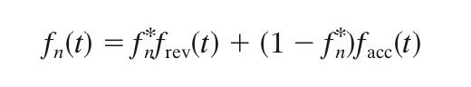
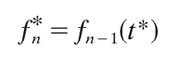
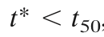
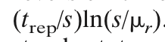
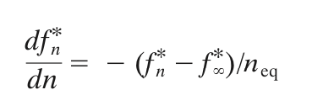
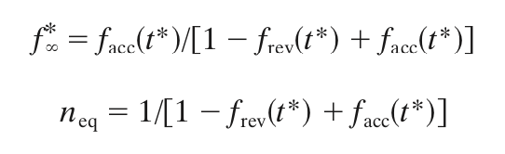
Стохастическая цепь передачи (Марковская цепь)
вероятность получения
мутанта
время передачи
=
t*
Notes:
Time dependence of the mutant frequency at different initial populations: purely mutant (reversion) (thicker line in upper panel), purely wild type (accumulation) (lower panel), or 50% mutant (growth competition) (dashed line). The thinner curve shows the intrapatient genetic distance T(t) during reversion. The horizontal bar is the time interval during which the base would be classified as variable (5 to 95%). Values shown in the upper left corner correspond to parameters as follows: the forward (wild type 3 mutant) and reverse mutation rates, 􏰐f and 􏰐r, corresponding to either A or C wild type; the replication cycle time, trep; and selection coefficient, s. The reversion half-time, t50, is given by the equation t50 􏰇 (trep/s)ln(s/􏰐r).

Slide 18
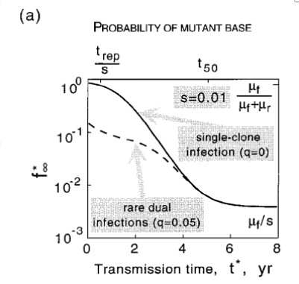
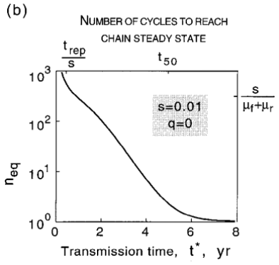
Стохастическая цепь передачи (Марковская цепь)
Notes:
Time dependence of the mutant frequency at different initial populations: purely mutant (reversion) (thicker line in upper panel), purely wild type (accumulation) (lower panel), or 50% mutant (growth competition) (dashed line). The thinner curve shows the intrapatient genetic distance T(t) during reversion. The horizontal bar is the time interval during which the base would be classified as variable (5 to 95%). Values shown in the upper left corner correspond to parameters as follows: the forward (wild type 3 mutant) and reverse mutation rates, 􏰐f and 􏰐r, corresponding to either A or C wild type; the replication cycle time, trep; and selection coefficient, s. The reversion half-time, t50, is given by the equation t50 􏰇 (trep/s)ln(s/􏰐r).

Slide 19
Выводы 1
Гетерозиготность в ВИЧ пациентах объясняется реверсией мутантов
При передаче из 1 источника, мутанты накапливаются из за «горлышка бутылки» и ранней передачи, что подавляет эффект естественного отбора
Notes:
A working model of evolution in pro. A quick initial switch of dom- inant epitopes redefines wild type for a number of sites, which then revert to this new wild type at speeds inversely proportional to their selection coefficients. (a) Time dependence of mutant frequency at three sites linked to an epitope. The three selection coefficients after the epitope switch are shown near correspond- ing curves. (b) Evolution of an individual consensus sequence at the three sites. pt, patient.

Slide 20
Насколько хорошо модель описывает ВИЧ?
Стохастическая передача одного вируса
Notes:
Time dependence of the mutant frequency at different initial popu- lations: purely mutant (reversion) (thicker line in upper panel), purely wild type (accumulation) (lower panel), or 50% mutant (growth competition) (dashed line). The thinner curve shows the intrapatient genetic distance T(t) during reversion. The horizontal bar is the time interval during which the base would be classified as variable (5 to 95%). Values shown in the upper left corner corre- spond to parameters as follows: the forward (wild type 3 mutant) and reverse mutation rates, 􏰐f and 􏰐r, corresponding to either A or C wild type; the repli- cation cycle time, trep; and selection coefficient, s. The reversion half-time, t50, is given by the equation t50 􏰇 (trep/s)ln(s/􏰐r).

Slide 21
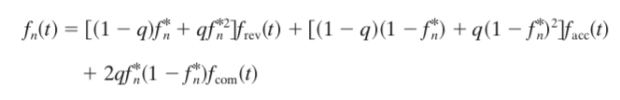
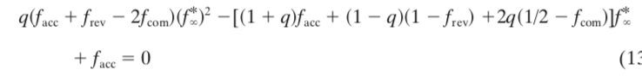
Модель 2.0: ко-инфекции

Slide 22
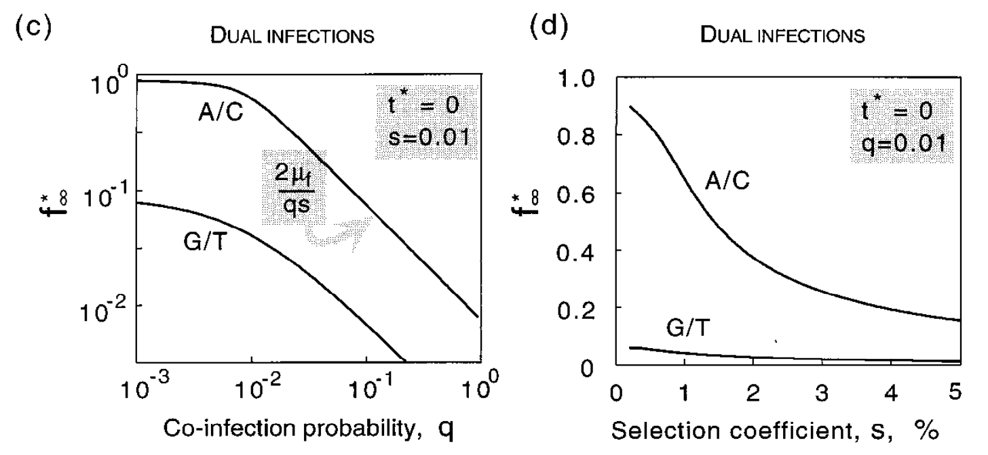
Коинфекции подавляют мутантов

Slide 23
Коинфекции подавляют мутантов

Slide 24
Выводы 2
10% ко-инфекции достаточно чтобы подавить накопление мутантов
Откуда же все-таки столько гетерозиготных мест?!
Notes:
A working model of evolution in pro. A quick initial switch of dom- inant epitopes redefines wild type for a number of sites, which then revert to this new wild type at speeds inversely proportional to their selection coefficients. (a) Time dependence of mutant frequency at three sites linked to an epitope. The three selection coefficients after the epitope switch are shown near correspond- ing curves. (b) Evolution of an individual consensus sequence at the three sites. pt, patient.

Slide 25
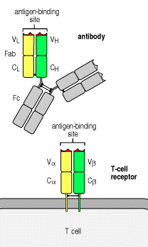
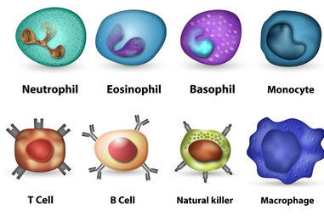
Модель 3.0: побег от иммунного отклика
Иммунные клетки
Two types of receptors

Slide 26
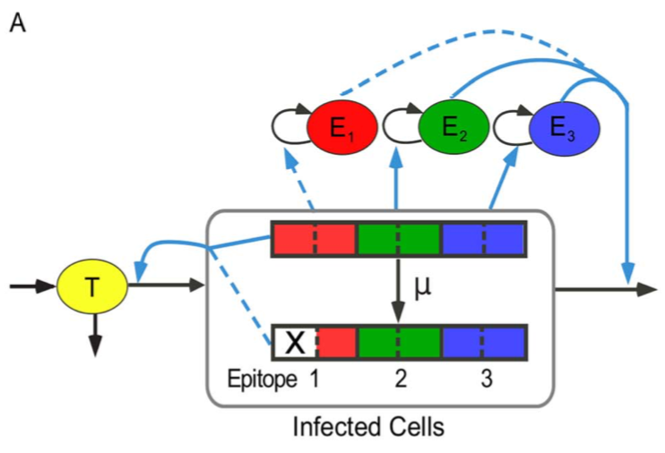
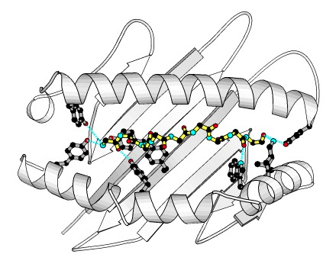
Модель 2.0: побег от иммунного отклика
MHC-I и пептид вируса

Slide 27
Модель 2.0: побег от иммунного отклика
распознаваем
плохо распознав.

Slide 28
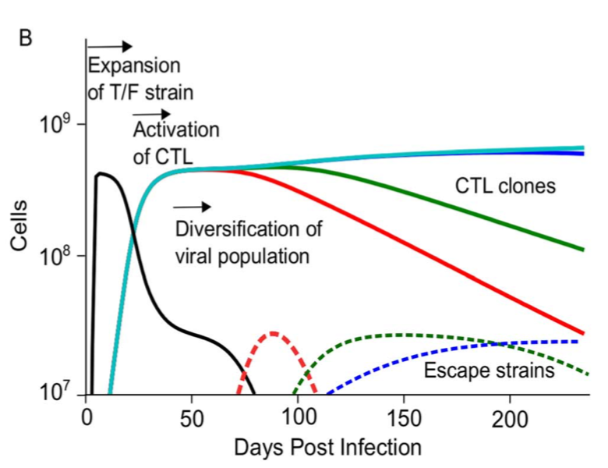
Как все это наблюдается
Notes:
A working model of evolution in pro. A quick initial switch of dom- inant epitopes redefines wild type for a number of sites, which then revert to this new wild type at speeds inversely proportional to their selection coefficients. (a) Time dependence of mutant frequency at three sites linked to an epitope. The three selection coefficients after the epitope switch are shown near correspond- ing curves. (b) Evolution of an individual consensus sequence at the three sites. pt, patient.

Slide 29
Выводы 3
Можем обьяснить гетерозиготные локусы
Но активных эпитопов в ВИЧ примерно 25-30
Можем обьяснить 30 гетерозиготных локусов, а их больше 1000
Нужен еще один фактор
Notes:
A working model of evolution in pro. A quick initial switch of dom- inant epitopes redefines wild type for a number of sites, which then revert to this new wild type at speeds inversely proportional to their selection coefficients. (a) Time dependence of mutant frequency at three sites linked to an epitope. The three selection coefficients after the epitope switch are shown near correspond- ing curves. (b) Evolution of an individual consensus sequence at the three sites. pt, patient.

Slide 30
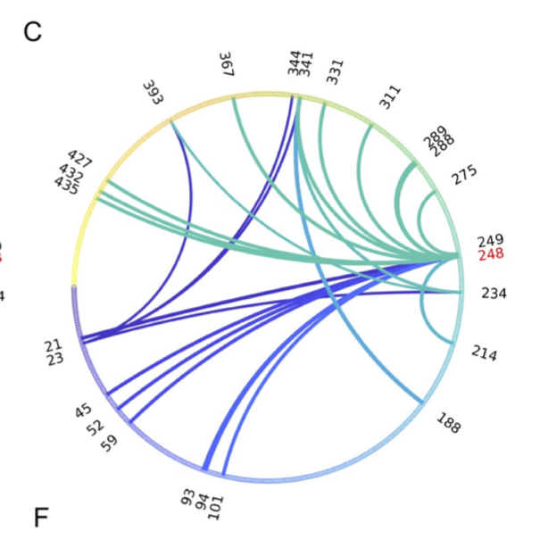
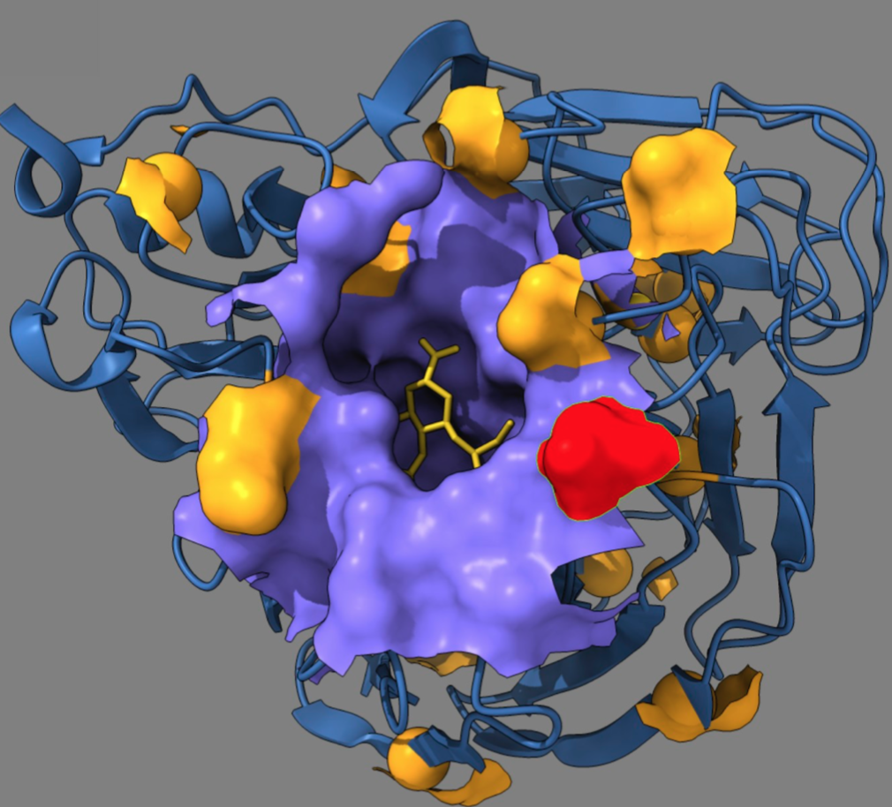
Модель 4.0. Эпистаз: компенсация
Откуда взялся грипп 2009: предсказание
Neurominidase influenza A H1N1
Pedruzzi & Rouzine PLOS Path. 2021
Notes:
A working model of evolution in pro. A quick initial switch of dom- inant epitopes redefines wild type for a number of sites, which then revert to this new wild type at speeds inversely proportional to their selection coefficients. (a) Time dependence of mutant frequency at three sites linked to an epitope. The three selection coefficients after the epitope switch are shown near correspond- ing curves. (b) Evolution of an individual consensus sequence at the three sites. pt, patient.

Slide 31
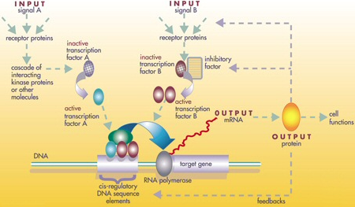
Эпистаз: генная регуляторная сеть
Notes:
A working model of evolution in pro. A quick initial switch of dom- inant epitopes redefines wild type for a number of sites, which then revert to this new wild type at speeds inversely proportional to their selection coefficients. (a) Time dependence of mutant frequency at three sites linked to an epitope. The three selection coefficients after the epitope switch are shown near correspond- ing curves. (b) Evolution of an individual consensus sequence at the three sites. pt, patient.

Slide 32
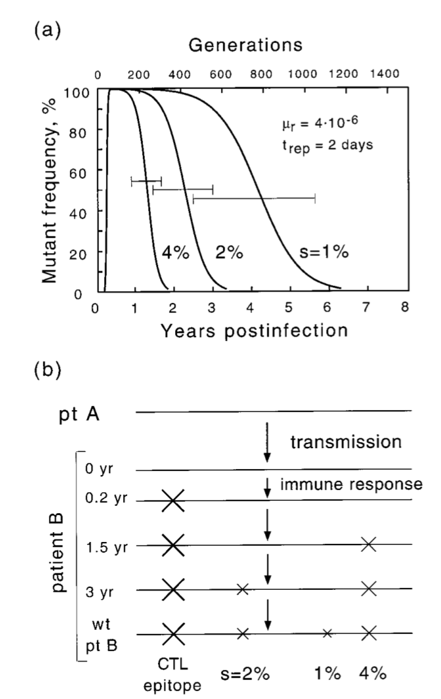
Побег от иммунного отклика и компенсация
Rouzine & Coffin 1999
Notes:
A working model of evolution in pro. A quick initial switch of dom- inant epitopes redefines wild type for a number of sites, which then revert to this new wild type at speeds inversely proportional to their selection coefficients. (a) Time dependence of mutant frequency at three sites linked to an epitope. The three selection coefficients after the epitope switch are shown near correspond- ing curves. (b) Evolution of an individual consensus sequence at the three sites. pt, patient.

Slide 33
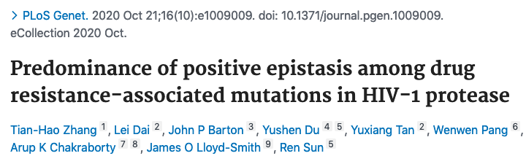
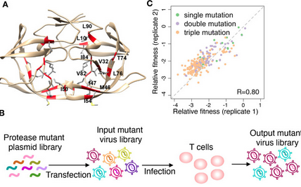
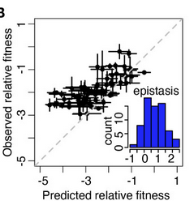
Проверка предказания
Notes:
A working model of evolution in pro. A quick initial switch of dom- inant epitopes redefines wild type for a number of sites, which then revert to this new wild type at speeds inversely proportional to their selection coefficients. (a) Time dependence of mutant frequency at three sites linked to an epitope. The three selection coefficients after the epitope switch are shown near correspond- ing curves. (b) Evolution of an individual consensus sequence at the three sites. pt, patient.

Slide 34
Основные выводы
Гетерозиготность в ВИЧ пациентах объясняется адаптацией (реверсией мутантов)
Первичные мутанты берутся из-за иммунного отклика в эпитопах
Мутанты в других местах берутся из-за компенсации первичных мутаций (эпистаза)
Notes:
A working model of evolution in pro. A quick initial switch of dom- inant epitopes redefines wild type for a number of sites, which then revert to this new wild type at speeds inversely proportional to their selection coefficients. (a) Time dependence of mutant frequency at three sites linked to an epitope. The three selection coefficients after the epitope switch are shown near correspond- ing curves. (b) Evolution of an individual consensus sequence at the three sites. pt, patient.

Slide 35

Суха теория, мой милый друг, А жизни дерево златое зеленеет
Grau, teurer Freund, ist alle Theorie und grün des Lebens goldner Baum
Johann Wolfgang von Goethe

